Slide 1
Dynamic Hedge Maze Simulator
By : Group 12
Venkata Vasudha Kirthi Chodimella
Zijie Wang
Akash Joshi

Slide 2
Parts of implementation
Locomotion alterations to Gazebo robot – Jumping/Teleportation
Customized variation of local search – Optimistic Local Search Algorithm
New obstacle detection mechanism, using linear & quadratic equations
More variations in Obstacle placement
Variable Maze Environment using Dynamic Obstacles

Slide 3
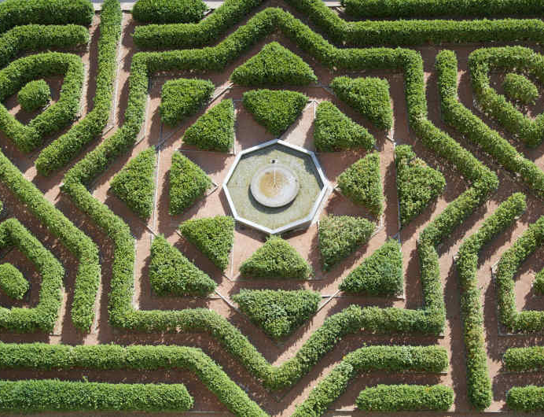

Introduction
Bot can move along 8 directions.
The maze will change with time randomly disrupting paths and creating new ones making things difficult
Local Search Algorithm

Slide 4
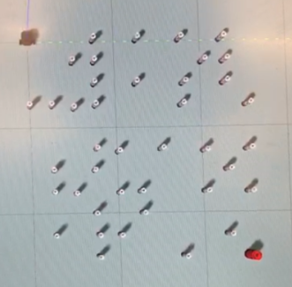
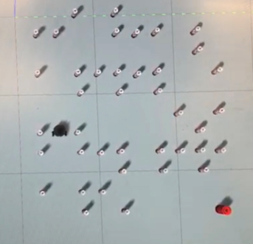
Dynamic Environment
We made some changes with the environment, now its dynamic
the cans can move from one position to another random position
The whole logic is when turtlebot executed one action, random number of cans will change its position, hen it’s finished, turtlebot will keep execute the next action.

Slide 5
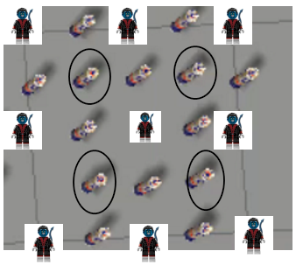
Different Obstacle Placement
The cans can be generated to obstruct diagonal movement. The cans are encircled in black
Cans are move randomly

Slide 6
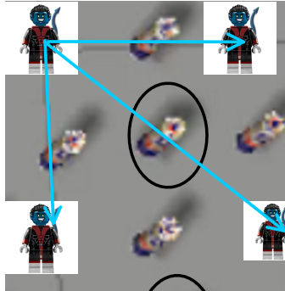
New Obstacle Detection implementation
We write a new get_successor, check_is_edge(named our_check_edge)function that takes into account dimensions of obstacle and agent and we use linear and quadratic equation to validate the presence of the obstacle.

Slide 7
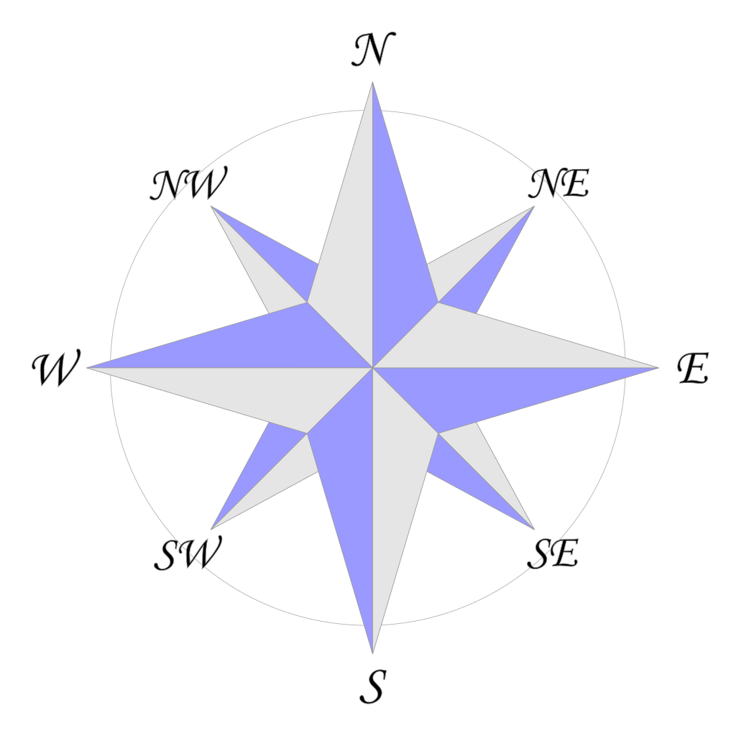

Directions of Teleportation/Jump
Added 4 new directions for the bot to move in NE,SW,SE,NW.
Added 2 new actions named TurnHalfCW and TurnHalfCCW.
Because of system bugs even on giving the correct move actions did result in intended motion, therefore the agent just changes its location by “teleportation" instead of executing movements.

Slide 8
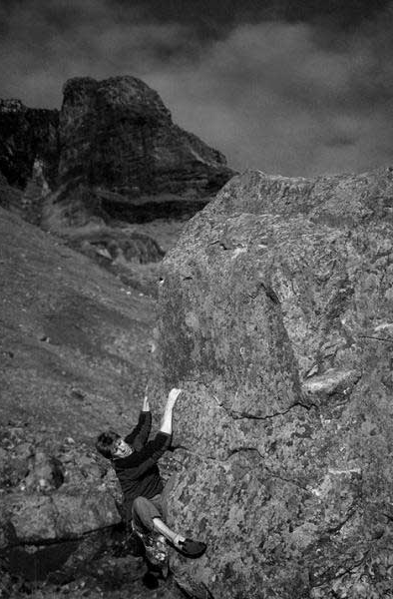
LOCAL SEARCH General Idea The Analogy
An amnesiac is climbing a mountain with the mountain terrain changing dynamically
Assumptions:
You have an General idea where the Goal state
You try to get closer to the goal
Sometimes you end up in a loop going to same states again and again
TO CONCLUDE:
Find the best current path of the choices available so far and move ahead

Slide 9
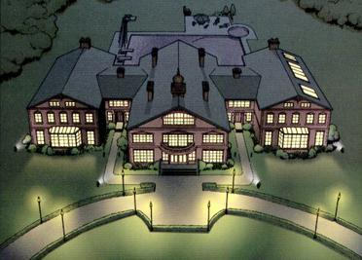
Decision making for next best state
The Next action is decided based upon Euclidean distance heuristic, the general idea is to move in the direction toward the goal

Slide 10
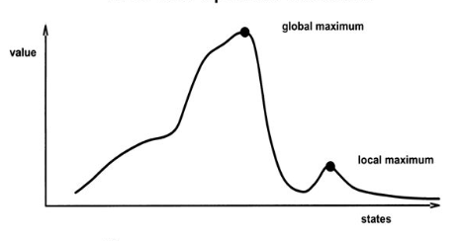
Drawbacks of local search

Slide 11
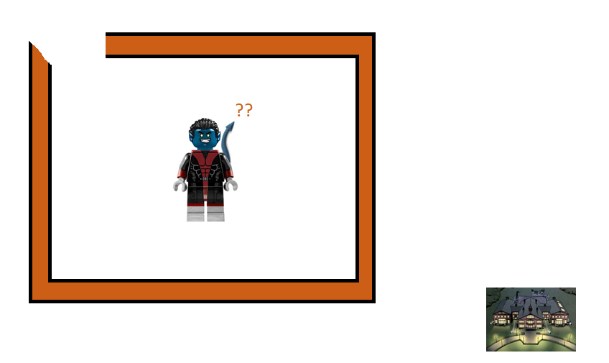
What if we get trapped in a dead end

Slide 12
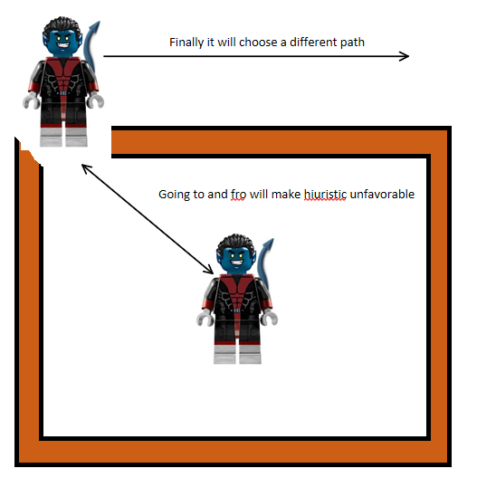
The resolution of the problem – Optimistic Local Search Algorithm
Implementation of a customized local search algorithm.
The algorithm only cares about which is the best next action, but.
In some cases, infinite loop could happened when turtlebot missed in local optimal.
Costs are added when it just goes back and forth in repetitive locations.

Slide 13
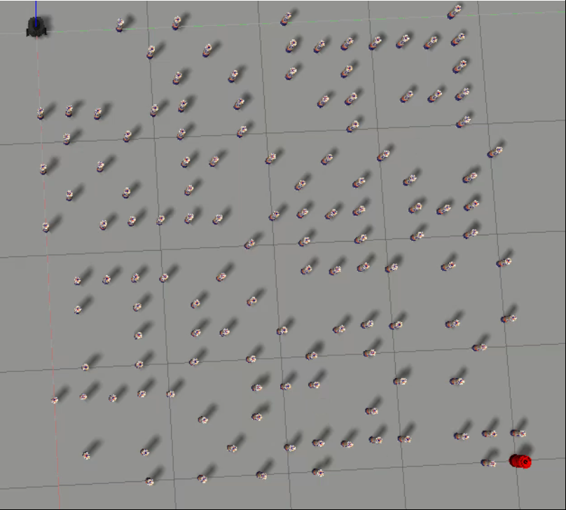
ScreenShots of results
Initial Environment

Slide 14
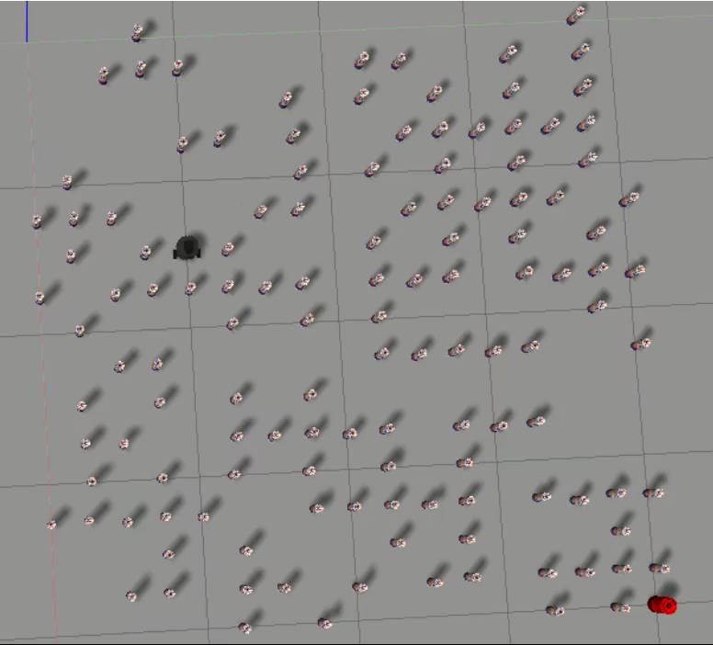
After Next few steps

Slide 15
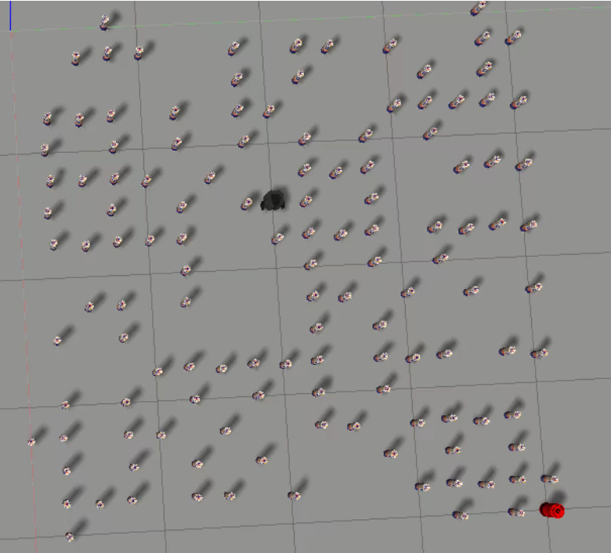
After Next few steps

Slide 16
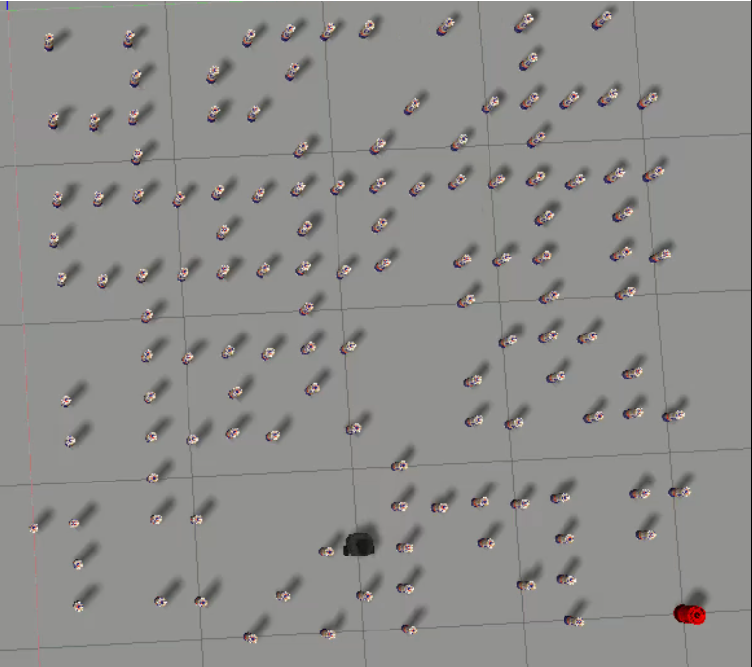
After Next few steps

Slide 17
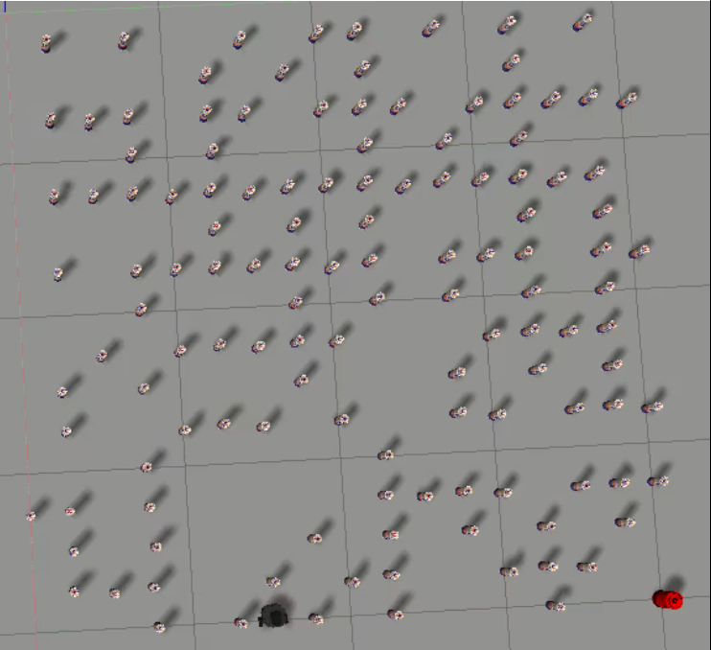
After Next few steps

Slide 18
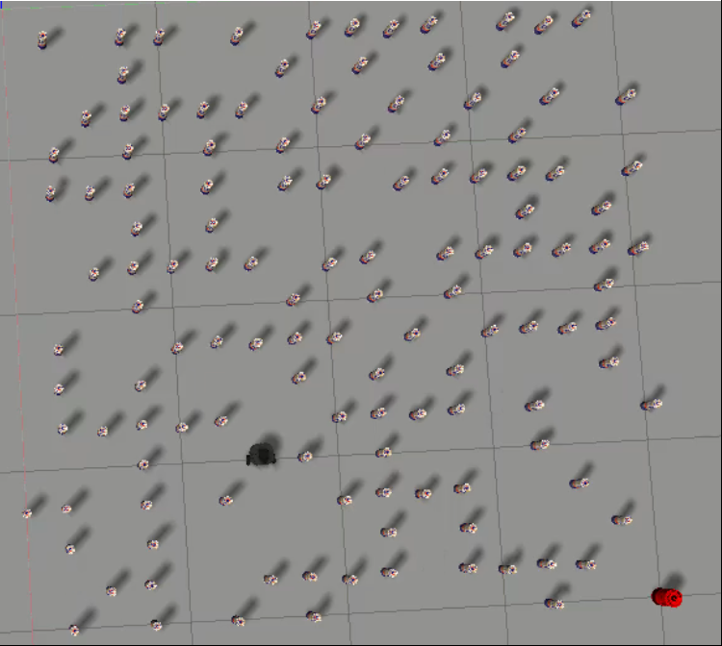
After Next few steps

Slide 19
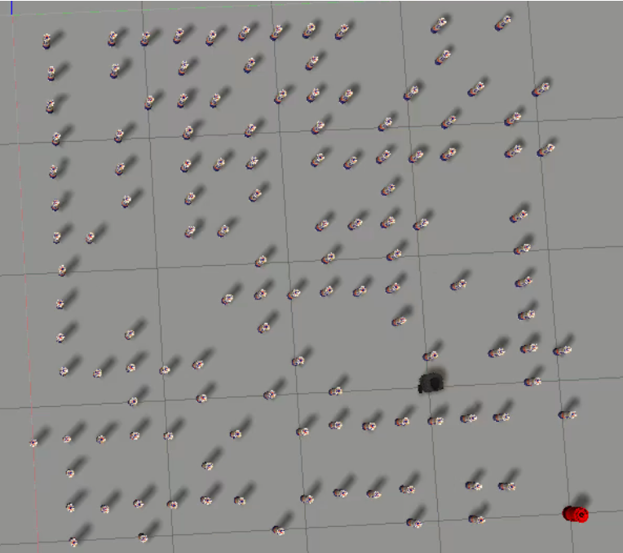
After Next few steps

Slide 20
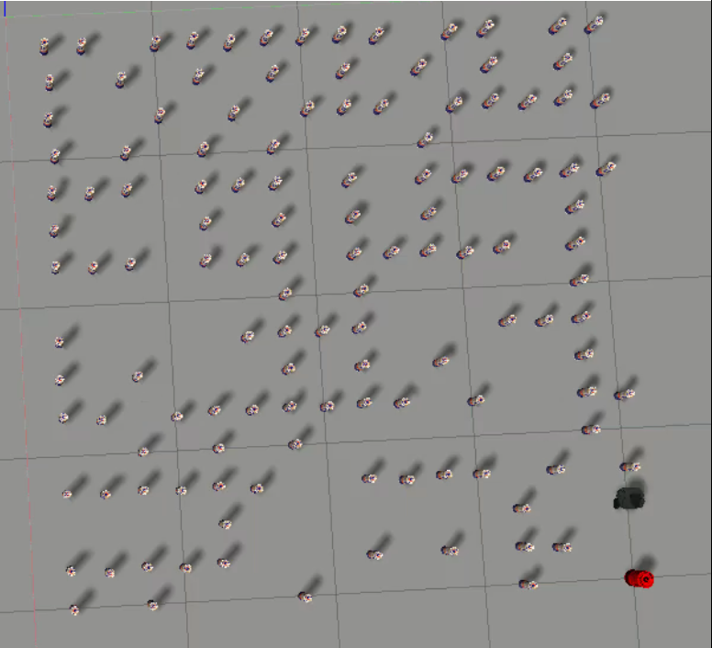
After Next few steps

Slide 21
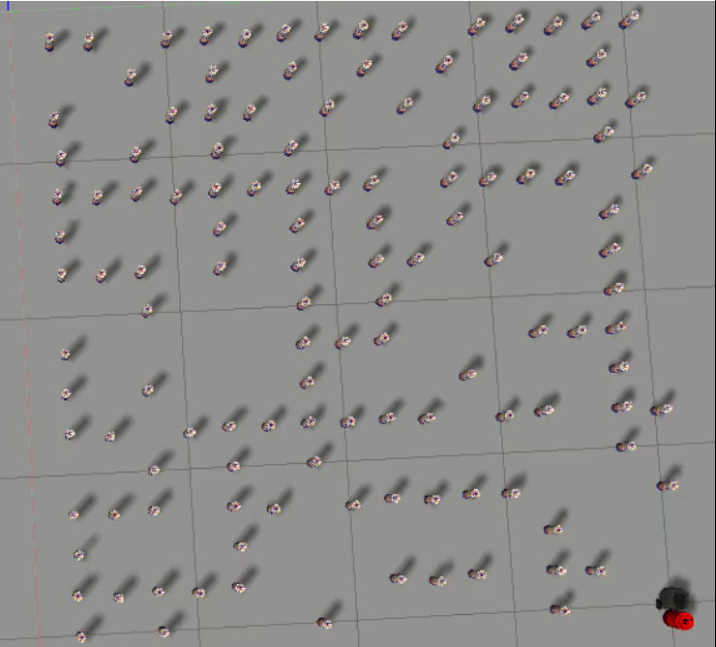
Final Destination

Slide 22
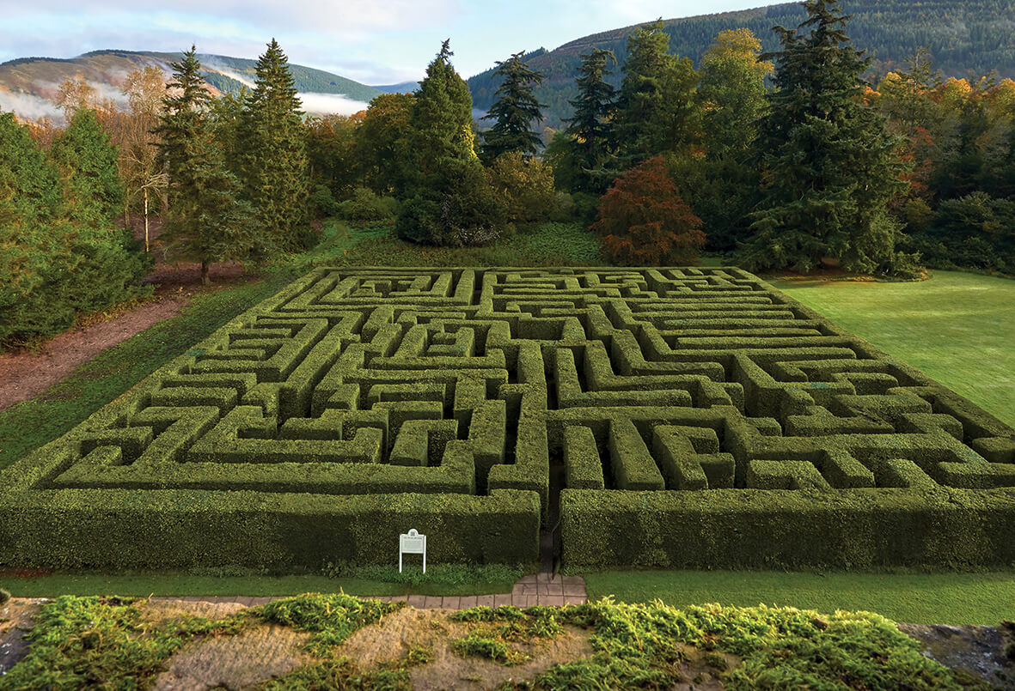
Thank you

